Slide 1
The Future Model for Community Justice
Aberdeen City CPP
06 July 2015

Slide 2
Outline
Overview of the new model;
Building blocks to the new model;
Transition and timescales.

Slide 3
New Model for Community Justice
Local strategic planning and delivery of community justice services - collectively;
Duties on a defined set of community justice partners to engage in this local strategic planning and delivery with accountability for planning and performance residing at this level;
The creation of Community Justice Scotland to provide leadership for the sector, opportunities for innovation, learning and development and independent professional assurance to Scottish Ministers on the collective achievement of community justice outcomes across Scotland and to provide improvement support where required; and
A focus on collaboration, including the opportunity to commission, manage or deliver services nationally where appropriate.

Slide 4
Scope of the Community Justice (Scotland) Bill
“…to make provision about community justice including:
establishing a new national body to oversee community justice; and
introducing requirements in relation to the achievement of particular nationally and locally determined outcomes; and for connected purposes”
The Bill is one building block…there are others…

Slide 5
New Model - Building Blocks
Successful transition
Community Justice (Scotland) Bill
Establishment of Community Justice Scotland
Community Justice Partners
Collaboration through partnership
Collective Responsibility
Quality
Improvement
Person-centred
Strategic Approach to Commissioning
Standards
Innovation, Learning and Development
National Strategy for Community Justice
Outcomes, Performance and Improvement Framework
New Funding Model

Slide 6
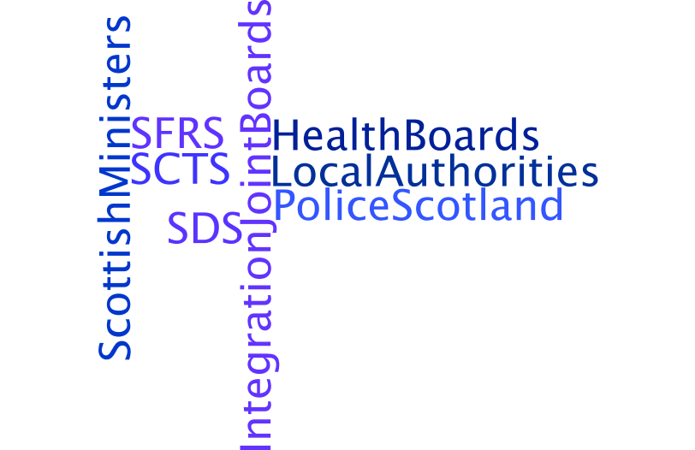
Community Justice Partners

Slide 7
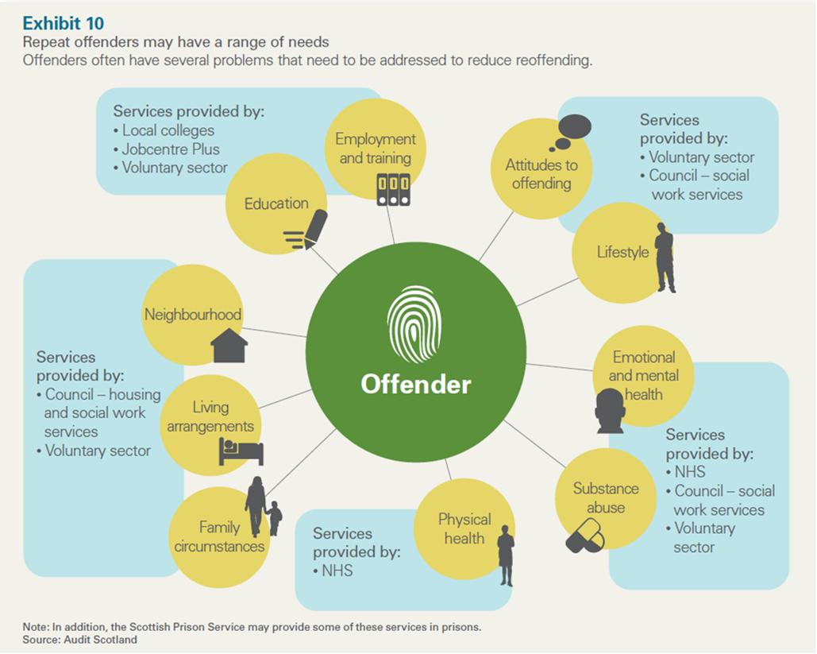

Slide 9
Broader Partners

Slide 10
Making Transition a Reality
Successful transition
=
Understanding the current picture
Capitalise upon the transitional funding
Transition plans
Community Justice Outcomes Improvement Plans
Establishing local arrangements
Service planning and delivery
Outcomes, Performance and Improvement Framework
Guidance for partners
National Strategy for Community Justice
Leveraging resources (£, staffing, information) locally
Forging and strengthening relationships locally – including communities and Third Sector
Building capability and capacity locally
Communication

Slide 11
Timescales and Forward Look
2014 – 2016/2017 - Awareness raising, the delivery of information from CJAs to their respective CPPs and partners and support on the transition process;
7 May 2015 – introduction of the Community Justice (Scotland) Bill;
During 2015/16 – development of the national strategy for community justice and the national outcomes, performance and improvement framework;
During 2015/16 – partners commence their collective planning and capacity-building activities – supported by transitional funding and in the community planning context;
January 2016 – partners make their plans for 2016/17 available to the Scottish Government for comment in support of the transition process;
1 April 2016 - partners take on responsibilities under their duties in new model in a transition year, working collectively through local arrangements;
During second half of 2016/17 – Community Justice Scotland shadow arrangements;
31/03/2017 – CJAs are formally dis-established;
1 April 2017 – Community Justice Scotland formally established and the new model for community justice in Scotland comes fully into effect.

